Slide 1
Hinrich Schütze and Christina Lioma
Lecture 1: Boolean Retrieval

Slide 2
Take-away
  Administrativa
  Boolean Retrieval: Design and data structures of a simple information retrieval system
  What topics will be covered in this class?
2

Slide 3
Outline
Introduction
Inverted index
Processing Boolean queries
Query optimization

Slide 4
Definition of information retrieval
Information retrieval (IR) is finding material (usually documents) of
an unstructured nature (usually text) that satisfies an information
need from within large collections (usually stored on computers).
4

Slide 5
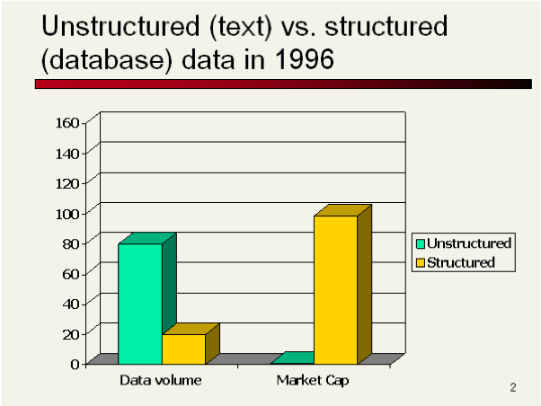
5

Slide 6
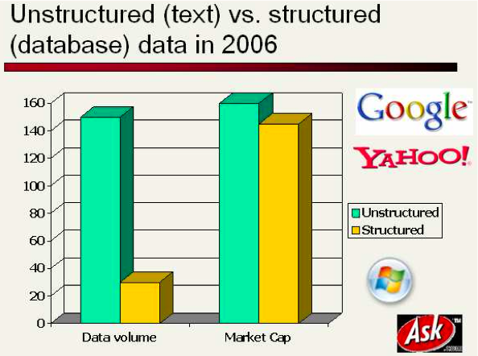
6

Slide 7
Boolean retrieval
  The Boolean model is arguably the simplest model to base an information retrieval system on.
  Queries are Boolean expressions, e.g., CAESAR AND BRUTUS
  The seach engine returns all documents that satisfy the
  Boolean expression.
  Does Google use the Boolean model?
7

Slide 8
Outline
Introduction
Inverted index
Processing Boolean queries
Query optimization

Slide 9
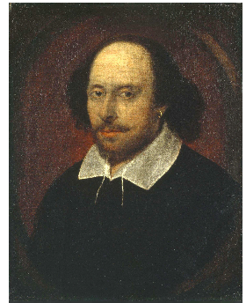
Unstructured data in 1650: Shakespeare
9

Slide 10
Unstructured data in 1650
  Which plays of Shakespeare contain the words BRUTUS AND CAESAR, but not CALPURNIA?
  One could grep all of Shakespeare’s plays for BRUTUS and CAESAR, then strip out lines containing CALPURNIA
  Why is grep not the solution?
    Slow (for large collections)
    grep is line-oriented, IR is document-oriented
    “NOT CALPURNIA” is non-trivial
    Other operations (e.g., find the word ROMANS near COUNTRYMAN ) not feasible
10

Slide 11
Term-document incidence matrix
 | Anthony and Cleopatra | Julius Caesar | The Tempest | Hamlet | Othello | Macbeth . . .
ANTHONY BRUTUS CAESAR CALPURNIA CLEOPATRA MERCY WORSER . . . | 1 1 1 0 1 1 1 | 1 1 1 1 0 0 0 | 0 0 0 0 0 1 1 | 0 1 1 0 0 1 1 | 0 0 1 0 0 1 1 | 1 0 1 0 0 1 0
Entry is 1 if term occurs. Example: CALPURNIA occurs in Julius Caesar. Entry is 0 if term doesn’t occur. Example: CALPURNIA
doesn’t occur in The tempest.
11

Slide 12
Incidence vectors
  So we have a 0/1 vector for each term.
  To answer the query BRUTUS AND CAESAR AND NOT CALPURNIA:
    Take the vectors for BRUTUS, CAESAR AND NOT CALPURNIA
    Complement the vector of CALPURNIA
    Do a (bitwise) and on the three vectors
    110100 AND 110111 AND 101111 = 100100
12

Slide 13
0/1 vector for BRUTUS
 | Anthony and Cleopatra | Julius Caesar | The Tempest | Hamlet | Othello | Macbeth . . .
ANTHONY BRUTUS CAESAR CALPURNIA CLEOPATRA MERCY WORSER . . . | 1 1 1 0 1 1 1 | 1 1 1 1 0 0 0 | 0 0 0 0 0 1 1 | 0 1 1 0 0 1 1 | 0 0 1 0 0 1 1 | 1 0 1 0 0 1 0
result: | 1 | 0 | 0 | 1 | 0 | 0
13

Slide 14
Answers to query
Anthony and Cleopatra, Act III, Scene ii
Agrippa [Aside to Domitius Enobarbus]: Why, Enobarbus,
              When Antony found Julius Caesar dead,
              He cried almost to roaring; and he wept
              When at Philippi he found Brutus slain.
Hamlet, Act III, Scene ii
Lord Polonius: I did enact Julius Caesar: I was killed i’ the Capitol; Brutus killed me.
14

Slide 15
Bigger collections
  Consider N = 10⁶ documents, each with about 1000 tokens
  ⇒ total of 10⁹ tokens
  On average 6 bytes per token, including spaces and
  punctuation ⇒ size of document collection is about 6 ・ 10⁹ = 6 GB
  Assume there are M = 500,000 distinct terms in the collection
  (Notice that we are making a term/token distinction.)
15

Slide 16
Can’t build the incidence matrix
  M = 500,000 × 10⁶ = half a trillion 0s and 1s.
  But the matrix has no more than one billion 1s.
    Matrix is extremely sparse.
  What is a better representations?
    We only record the 1s.
16

Slide 17
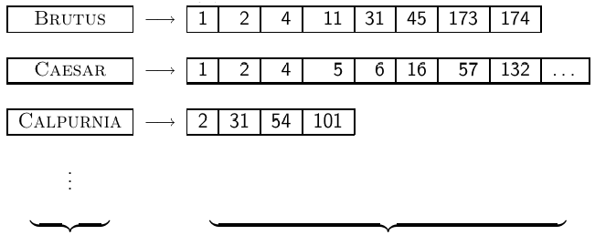
Inverted Index
  For each term t, we store a list of all documents that contain t.
dictionary postings
17

Slide 18
Inverted Index
  For each term t, we store a list of all documents that contain t.
dictionary postings
18

Slide 19
Inverted Index
  For each term t, we store a list of all documents that contain t.
dictionary postings
19

Slide 20



Inverted index construction
Collect the documents to be indexed:
Tokenize the text, turning each document into a list of tokens:
Do linguistic preprocessing, producing a list of normalized tokens, which are the indexing terms:
Index the documents that each term occurs in by creating an
inverted index, consisting of a dictionary and postings.

Slide 21
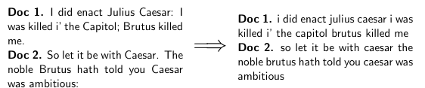
Tokenizing and preprocessing
21

Slide 22
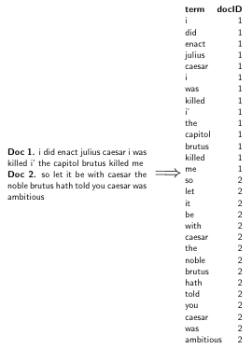
Generate posting
22

Slide 23
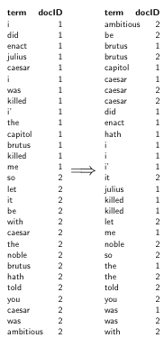
Sort postings
23

Slide 24
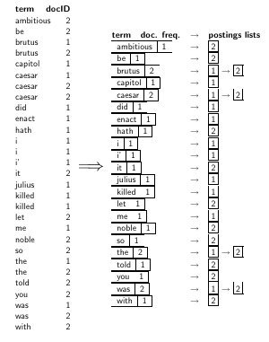
Create postings lists, determine document frequency
24

Slide 25
Split the result into dictionary and postings file
dictionary postings
25

Slide 26
Later in this course
  Index construction: how can we create inverted indexes for large collections?
  How much space do we need for dictionary and index?
  Index compression: how can we efficiently store and process indexes for large collections?
  Ranked retrieval: what does the inverted index look like when we want the “best” answer?
26

Slide 27
Outline
Introduction
Inverted index
Processing Boolean queries
Query optimization

Slide 28
Simple conjunctive query (two terms)
  Consider the query: BRUTUS AND CALPURNIA
  To find all matching documents using inverted index:
    Locate BRUTUS in the dictionary
    Retrieve its postings list from the postings file
    Locate CALPURNIA in the dictionary
    Retrieve its postings list from the postings file
    Intersect the two postings lists
    Return intersection to user
28

Slide 29
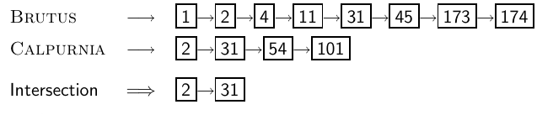
Intersecting two posting lists
  This is linear in the length of the postings lists.
  Note: This only works if postings lists are sorted.
29

Slide 30
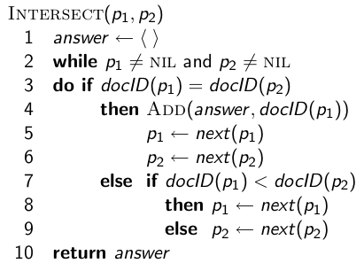
Intersecting two posting lists
30

Slide 31

Query processing: Exercise
  Compute hit list for ((paris AND NOT france) OR lear)
31

Slide 32
Boolean queries
  The Boolean retrieval model can answer any query that is a Boolean expression.
    Boolean queries are queries that use AND, OR and NOT to join
    query terms.
    Views each document as a set of terms.
    Is precise: Document matches condition or not.
  Primary commercial retrieval tool for 3 decades
  Many professional searchers (e.g., lawyers) still like Boolean queries.
    You know exactly what you are getting.
  Many search systems you use are also Boolean: spotlight, email, intranet etc.
32

Slide 33
Commercially successful Boolean retrieval: Westlaw
  Largest commercial legal search service in terms of the number of paying subscribers
  Over half a million subscribers performing millions of searches a day over tens of terabytes of text data
  The service was started in 1975.
  In 2005, Boolean search (called “Terms and Connectors” by Westlaw) was still the default, and used by a large percentage of users . . .
  . . . although ranked retrieval has been available since 1992.
33

Slide 34
Westlaw: Example queries
Information need: Information on the legal theories involved in
preventing the disclosure of trade secrets by employees formerly
employed by a competing company Query: “trade secret” /s
disclos! /s prevent /s employe! Information need: Requirements
for disabled people to be able to access a workplace Query: disab! /p access! /s work-site work-place (employment /3 place)
Information need: Cases about a host’s responsibility for drunk
guests Query: host! /p (responsib! liab!) /p (intoxicat! drunk!)
/p guest
34

Slide 35
Westlaw: Comments
  Proximity operators: /3 = within 3 words, /s = within a sentence, /p = within a paragraph
  Space is disjunction, not conjunction! (This was the default in search pre-Google.)
  Long, precise queries: incrementally developed, not like web search
  Why professional searchers often like Boolean search: precision, transparency, control
  When are Boolean queries the best way of searching? Depends on: information need, searcher, document collection, . . .
35

Slide 36
Outline
Introduction
Inverted index
Processing Boolean queries
Query optimization

Slide 37
Query optimization
  Consider a query that is an and of n terms, n > 2
  For each of the terms, get its postings list, then and them together
  Example query: BRUTUS AND CALPURNIA AND CAESAR
  What is the best order for processing this query?
37

Slide 38
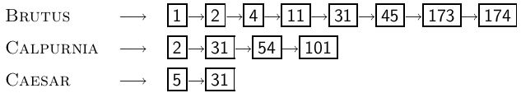
Query optimization
  Example query: BRUTUS AND CALPURNIA AND CAESAR
  Simple and effective optimization: Process in order of increasing frequency
  Start with the shortest postings list, then keep cutting further
  In this example, first CAESAR, then CALPURNIA, then BRUTUS
38

Slide 39
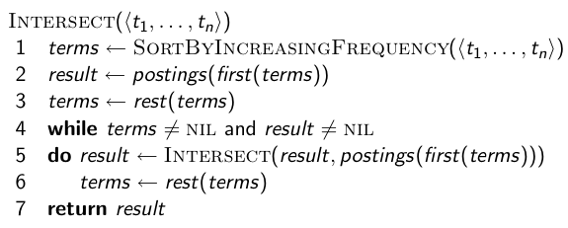
Optimized intersection algorithm for
conjunctive queries
39

Slide 40
More general optimization
  Example query: (MADDING OR CROWD) and (IGNOBLE OR STRIFE)
  Get frequencies for all terms
  Estimate the size of each or by the sum of its frequencies (conservative)
  Process in increasing order of or sizes
40

